Slide 1
GaN Readout IC
Kees Kroep

Slide 2
Silicon Photo Sensor

Slide 3
Silicon Photo Sensor
V_{bias}

Slide 4
Silicon Photo Sensor
V_{bias}

Slide 5
Gallium Nitride
Large bandgap -> intrinsic solarblind
Solid state
No alternative!
Weak material
Inconsistent material
High breakdown voltage

Slide 6
GaN sensor

Slide 7
GaN sensor

Slide 8
Preethi’s design
Source
follower
vbo
Voltage limiter
Opamp
Source follower
in
out
Integation
capacitance

Slide 9
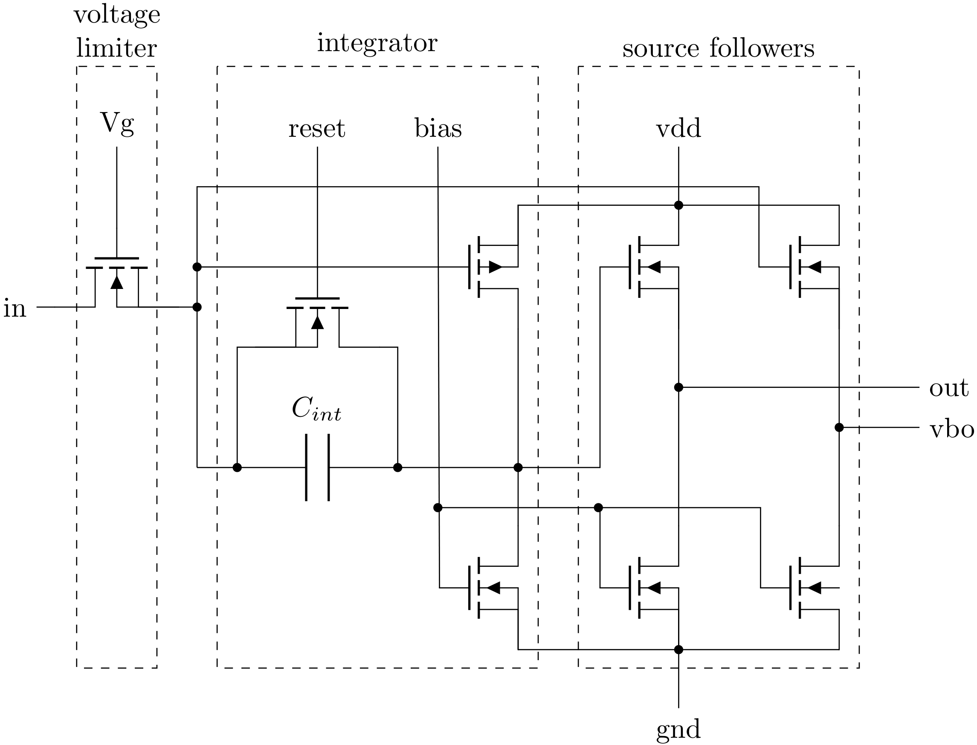
Preethi’s design

Slide 10
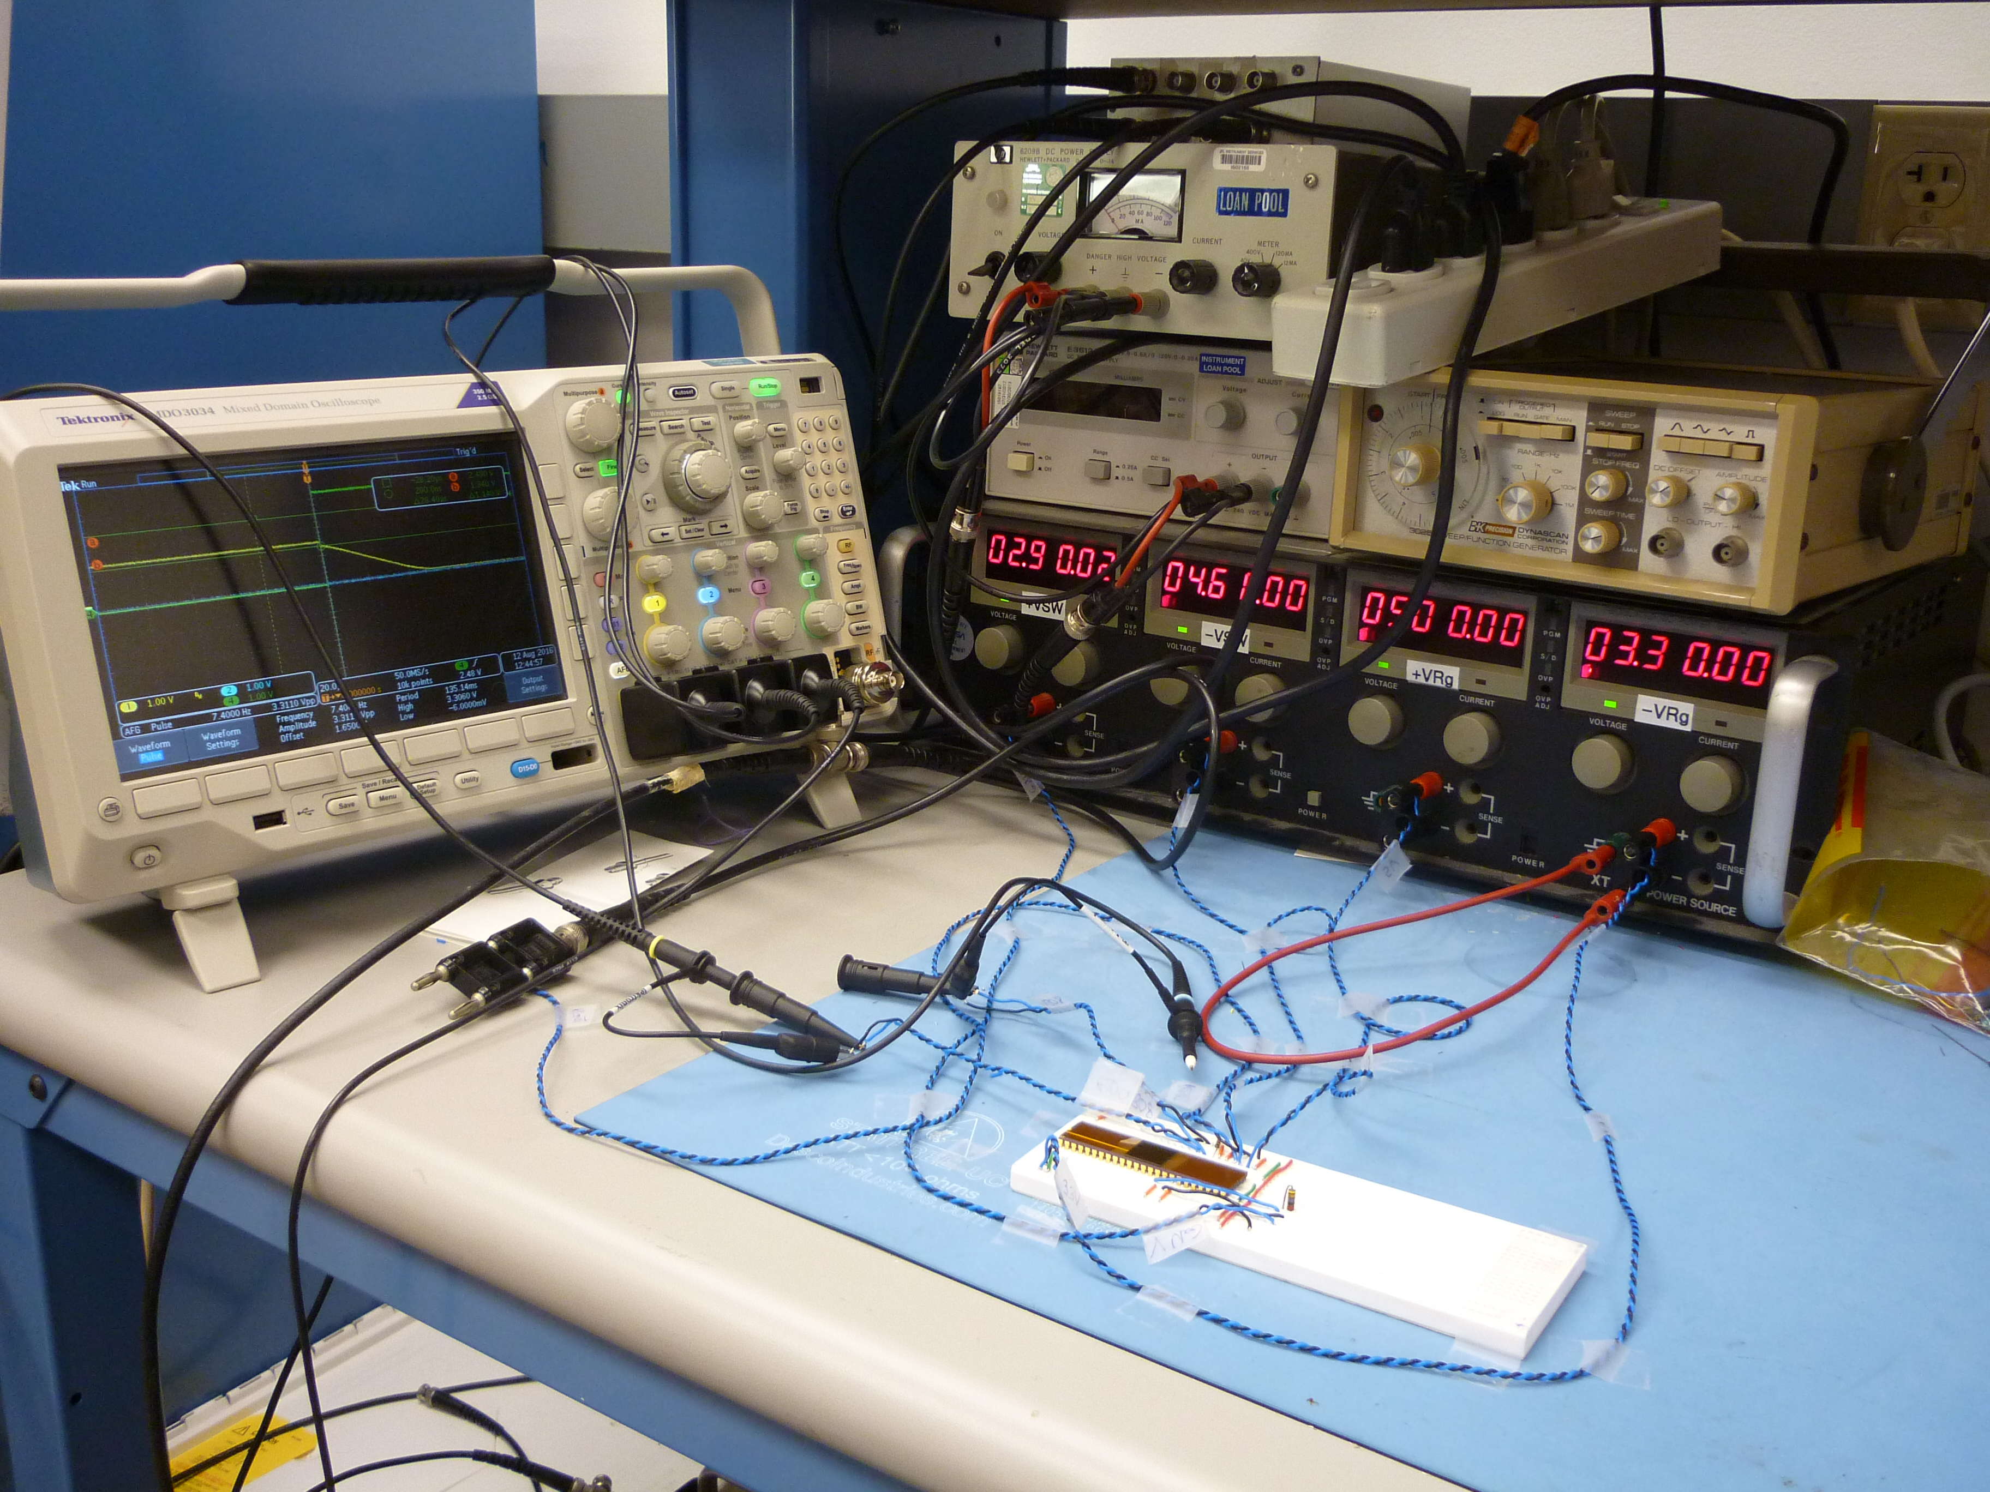
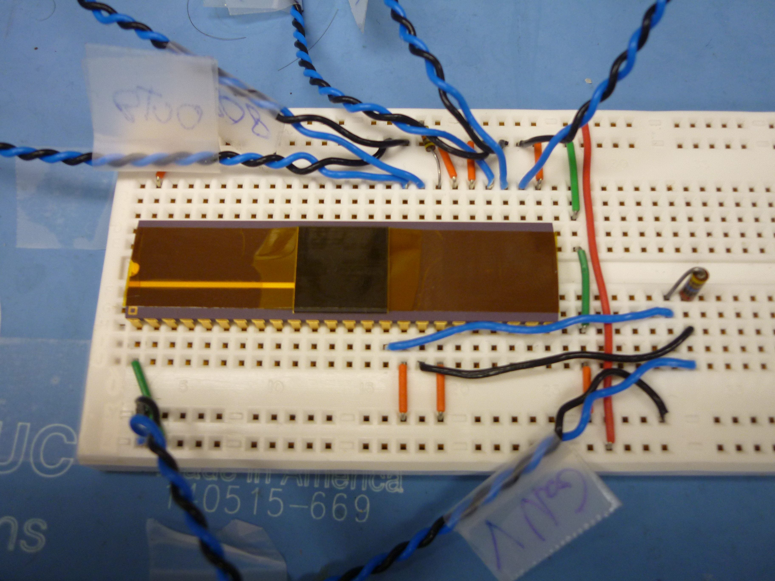
Methodology and Setup #1

Slide 11
Methodology and Setup #1
oscilloscope
computer
AFG reset
latexmk
sampling

Slide 12
Early problems
Scale
Ground
Basic understanding of design
Laptop connected to power grid

Slide 13
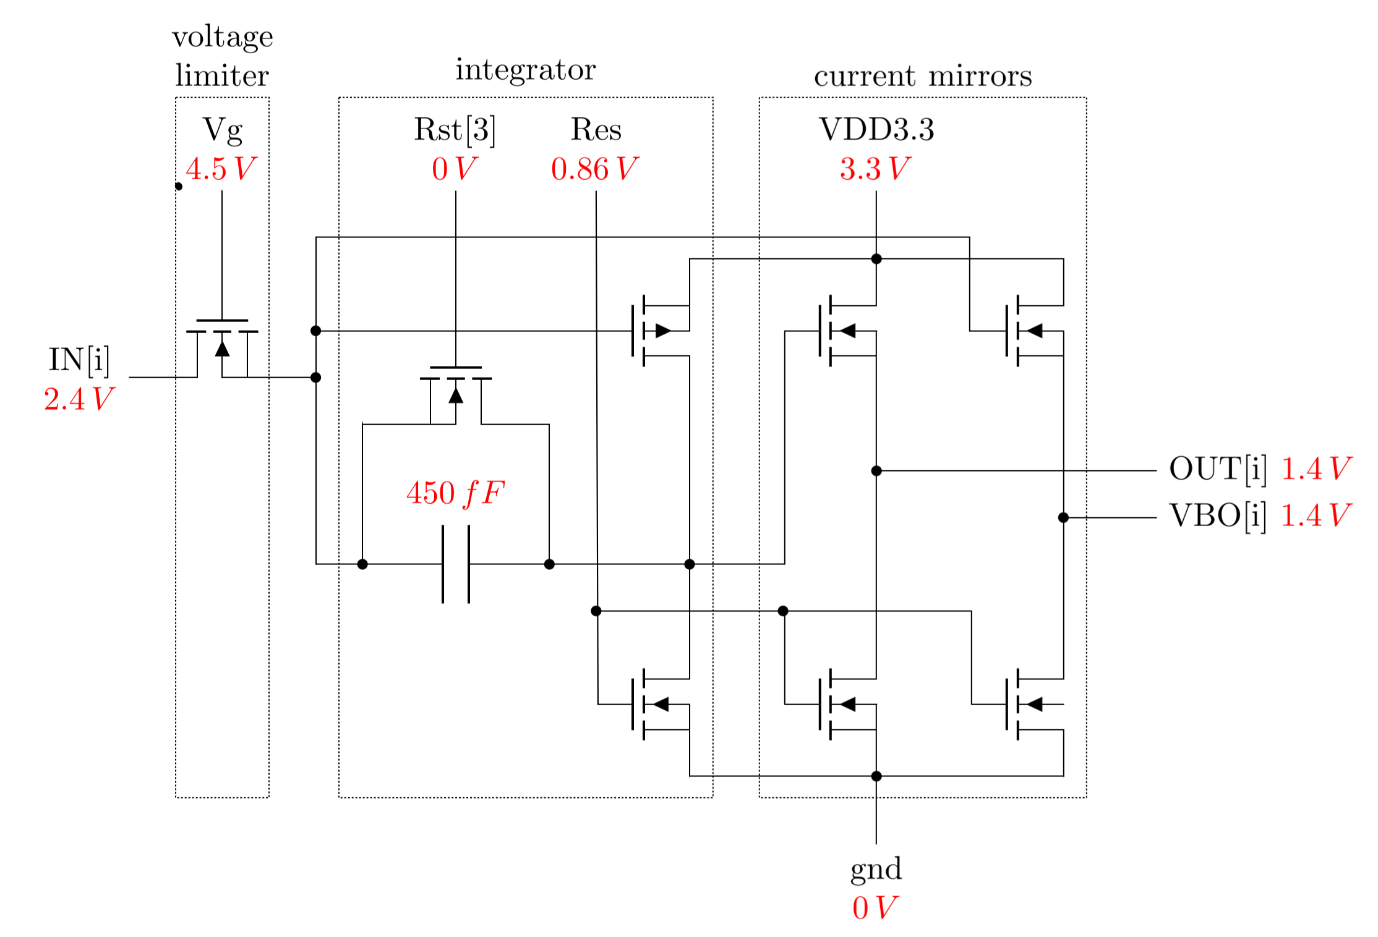
Reset mode

Slide 14
Methodology and Setup #2
oscilloscope
computer
AFG reset
terminal
trigger
USB Stick
octave-cli
averaging
latexmk
sampling

Slide 15
Integrator
Source
follower
vbo
Voltage limiter
Opamp
Source follower
in
out
Integation
capacitance

Slide 16
Integrator
Source
follower
vbo
Voltage limiter
Opamp
Source follower
in
out
Integation
capacitance

Slide 17
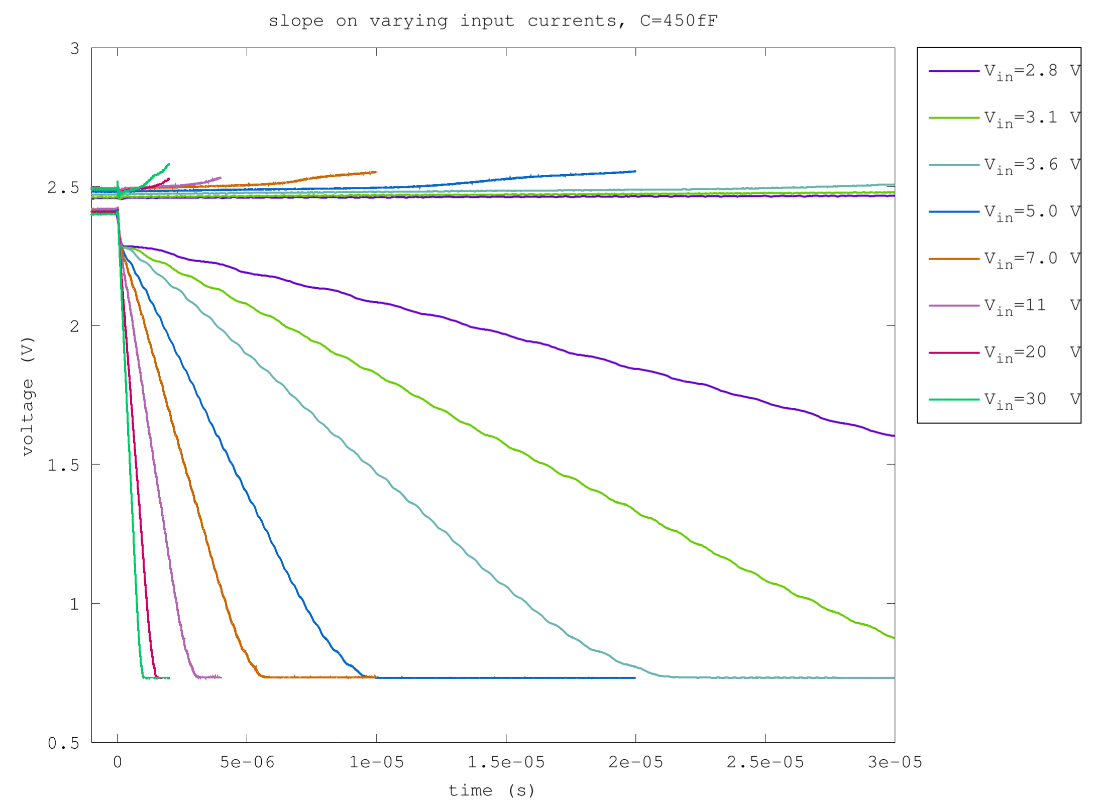
Integrator
Source
follower
vbo
Voltage limiter
Opamp
Source follower
in
out
Integation
capacitance

Slide 18
Source Follower
Source
follower
vbo
Voltage limiter
Opamp
Source follower
in
out
Integation
capacitance

Slide 19
Source Follower
Source
follower
vbo
Voltage limiter
Opamp
Source follower
in
out
Integation
capacitance

Slide 20
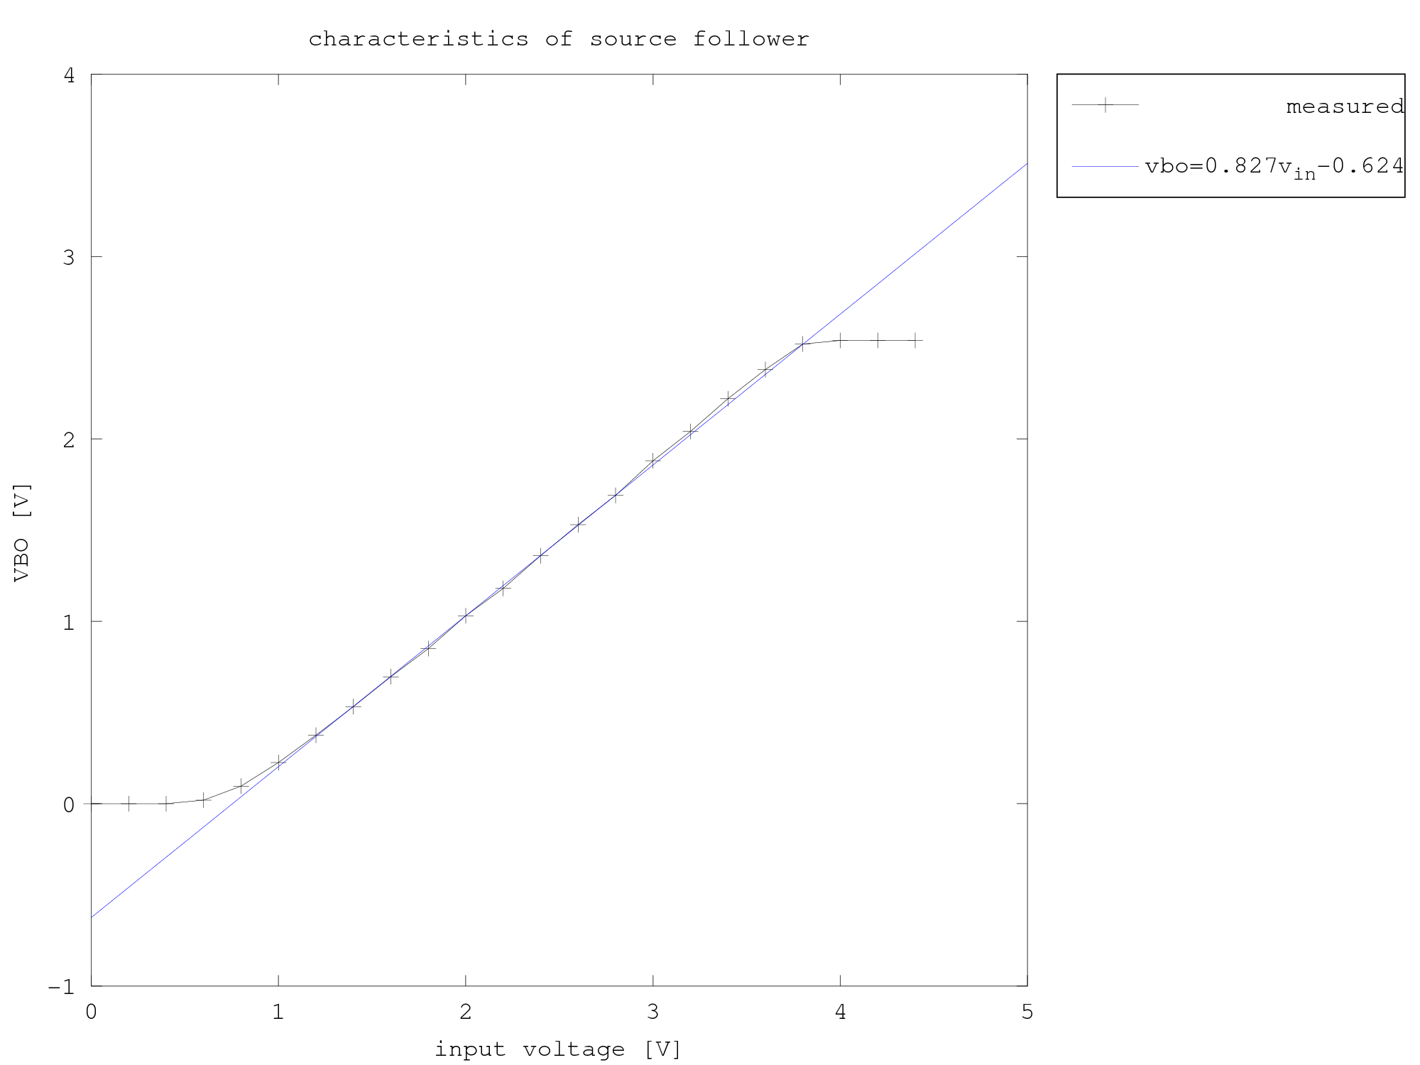
Source Follower
Source
follower
vbo
Voltage limiter
Opamp
Source follower
in
out
Integation
capacitance

Slide 21
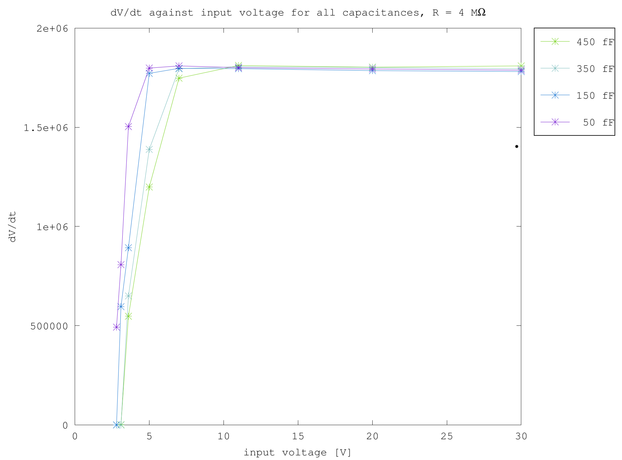
Source Follower
Source
follower
vbo
Voltage limiter
Opamp
Source follower
in
out
Integation
capacitance

Slide 22
Integration Capacitor
Source
follower
vbo
Voltage limiter
Opamp
Source follower
in
out
Integation
capacitance

Slide 23
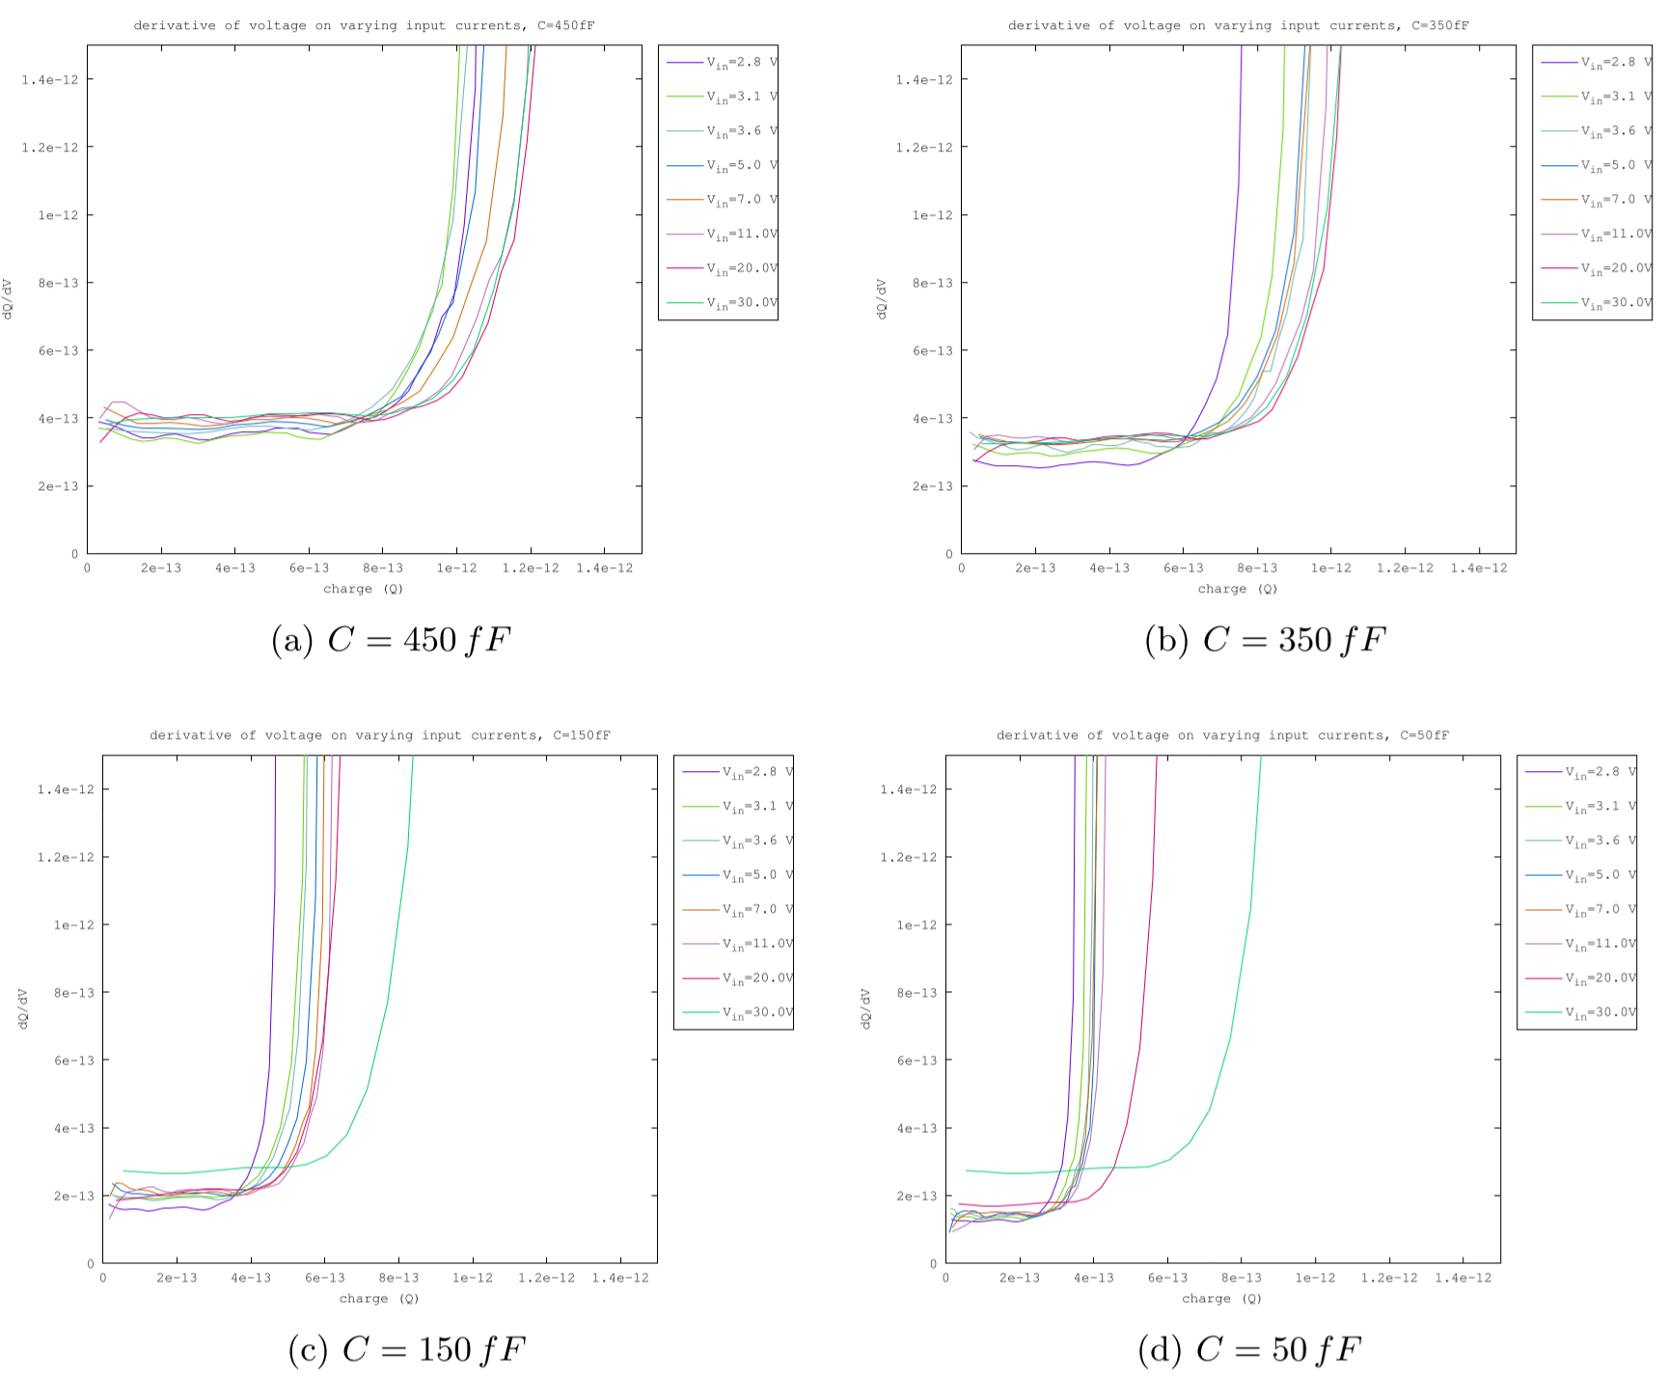
Integration Capacitance
Source
follower
vbo
Voltage limiter
Opamp
Source follower
in
out
Integation
capacitance

Slide 24
VBO
Source
follower
vbo
Voltage limiter
Opamp
Source follower
in
out
Integation
capacitance

Slide 25
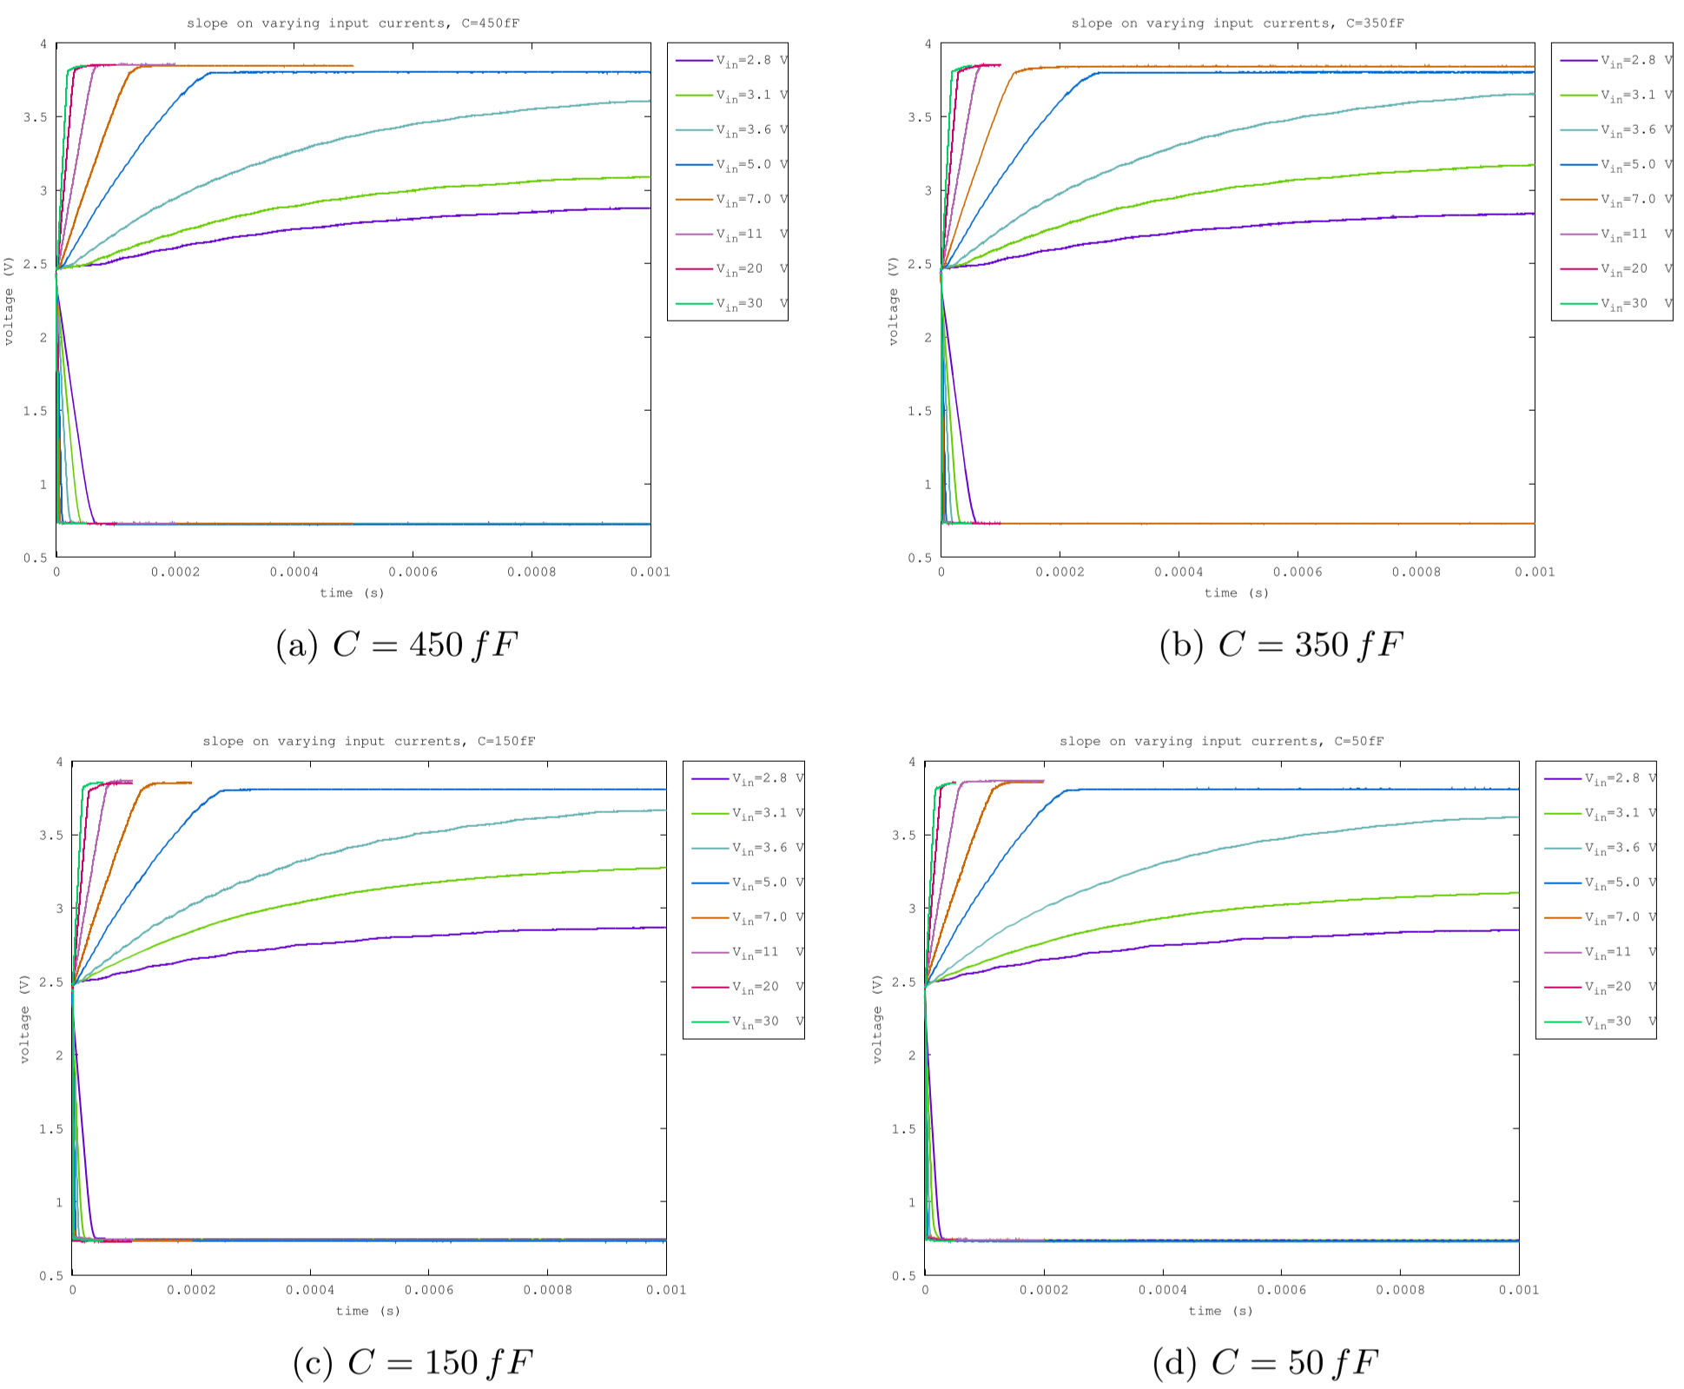
VBO
Source
follower
vbo
Voltage limiter
Opamp
Source follower
in
out
Integation
capacitance

Slide 26
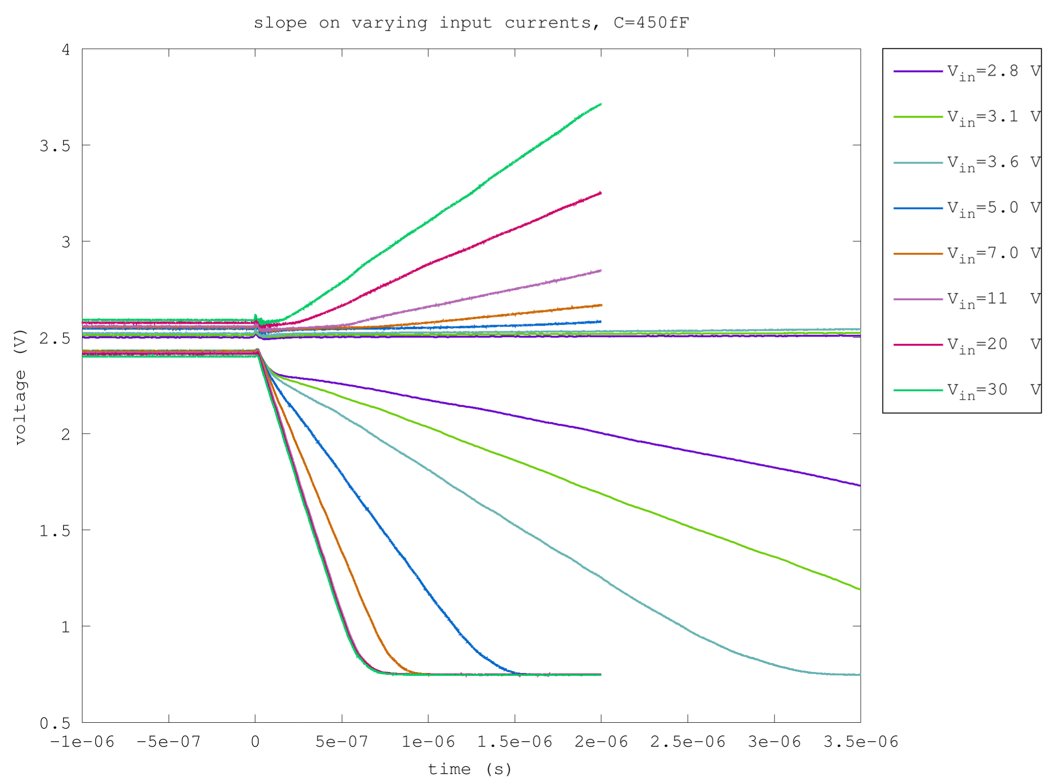
VBO
Source
follower
vbo
Voltage limiter
Opamp
Source follower
in
out
Integation
capacitance

Slide 27
Voltage limiter
Source
follower
vbo
Voltage limiter
Opamp
Source follower
in
out
Integation
capacitance

Slide 28
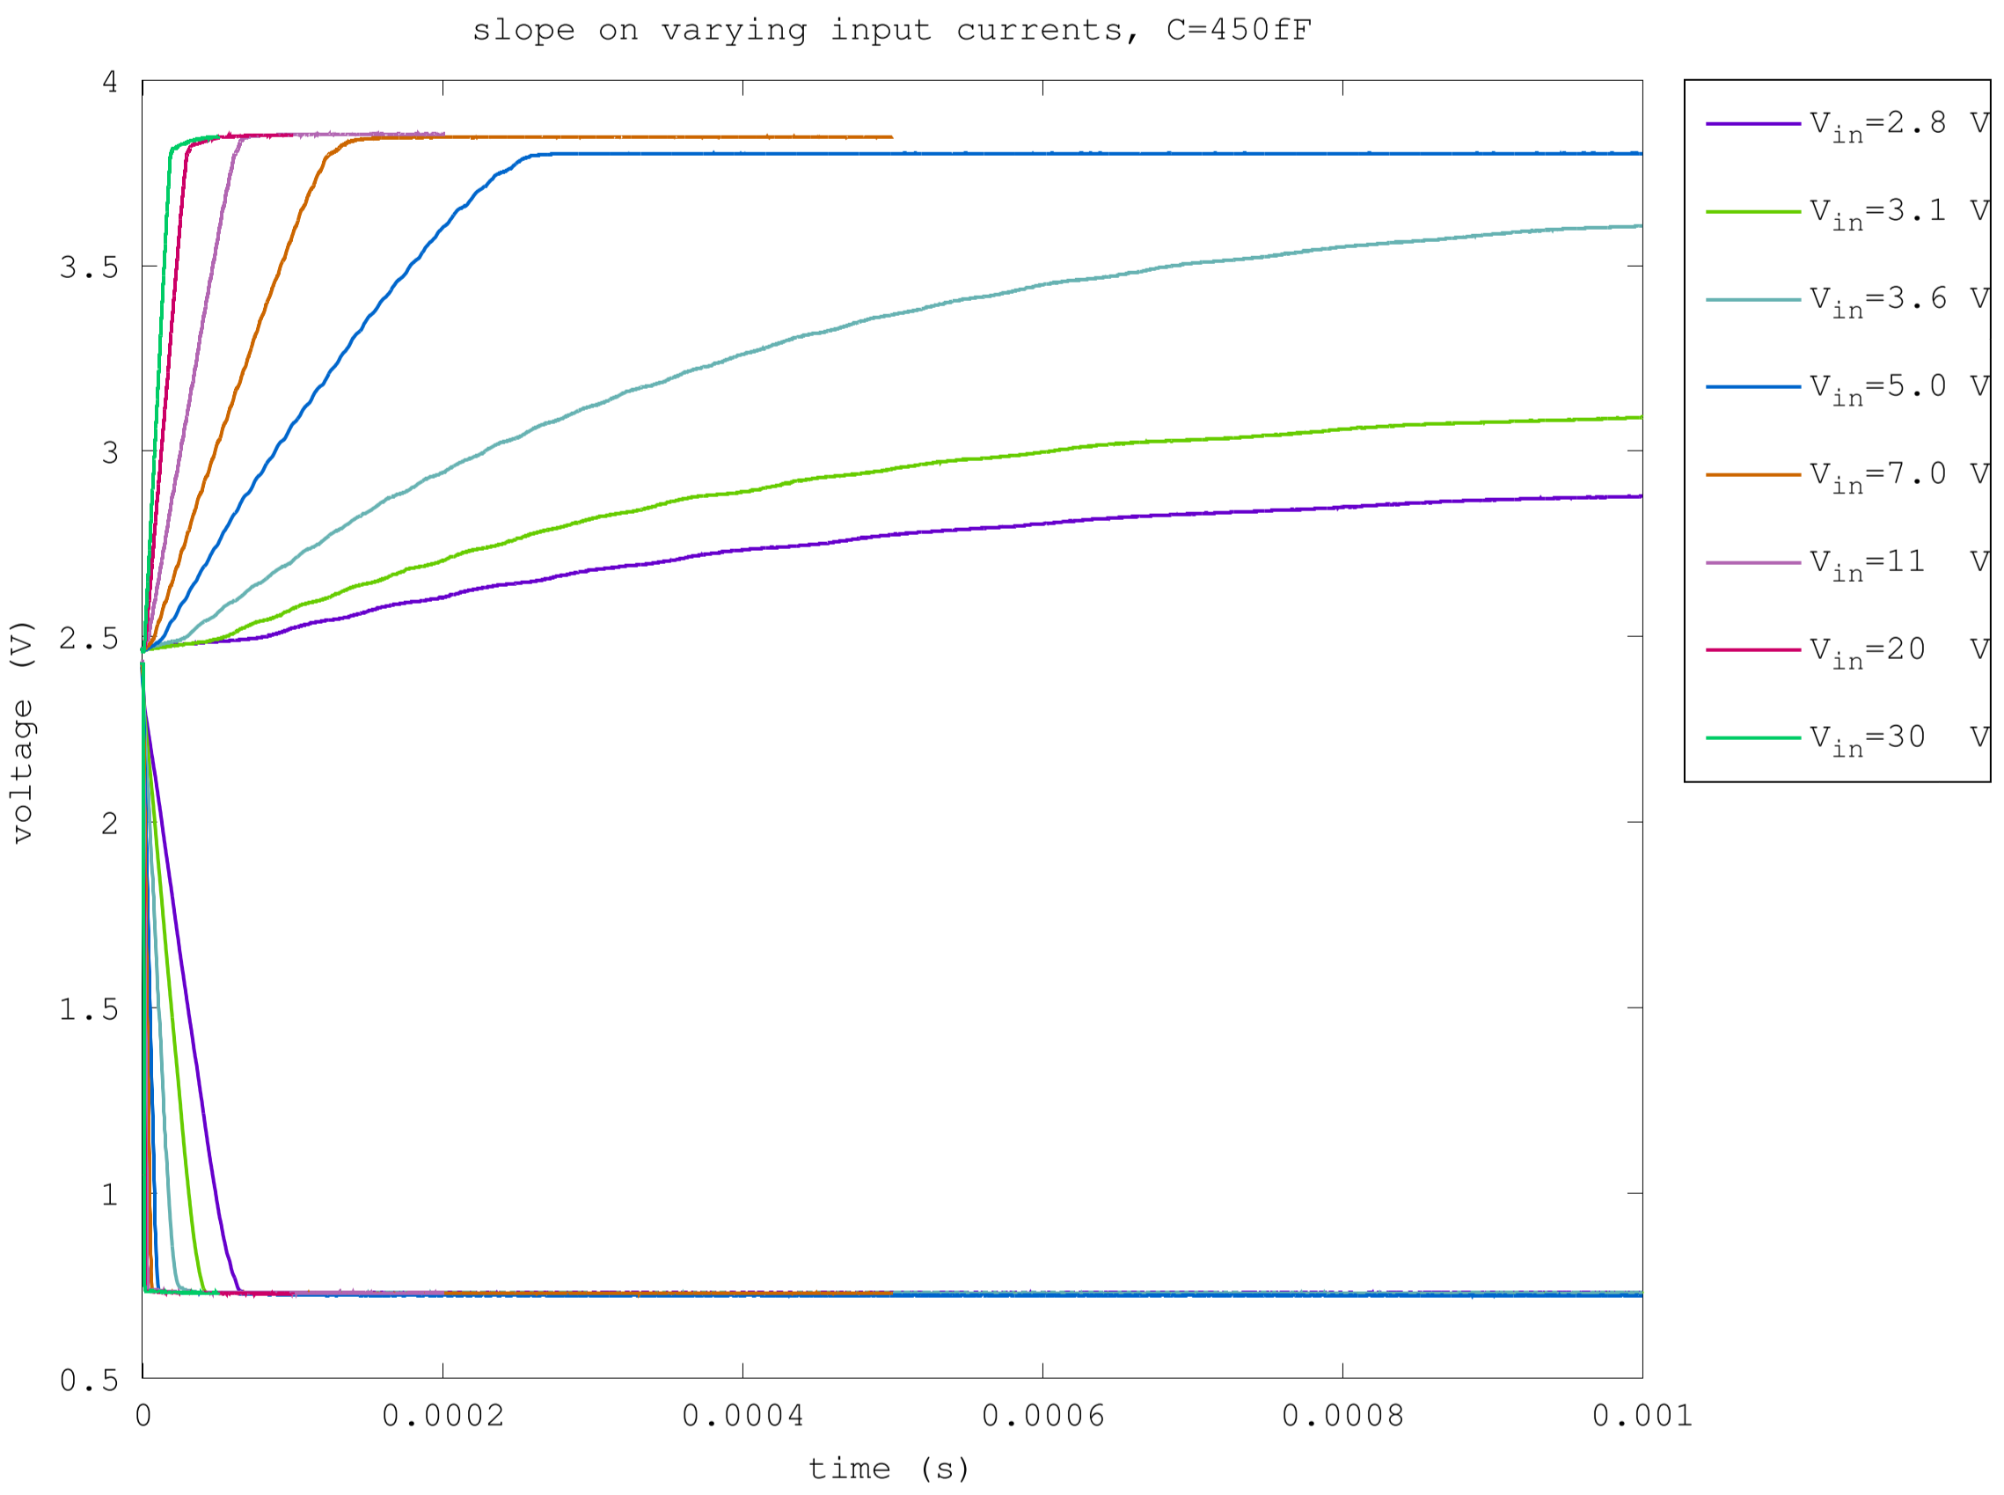
Voltage limiter
Source
follower
vbo
Voltage limiter
Opamp
Source follower
in
out
Integation
capacitance

Slide 29
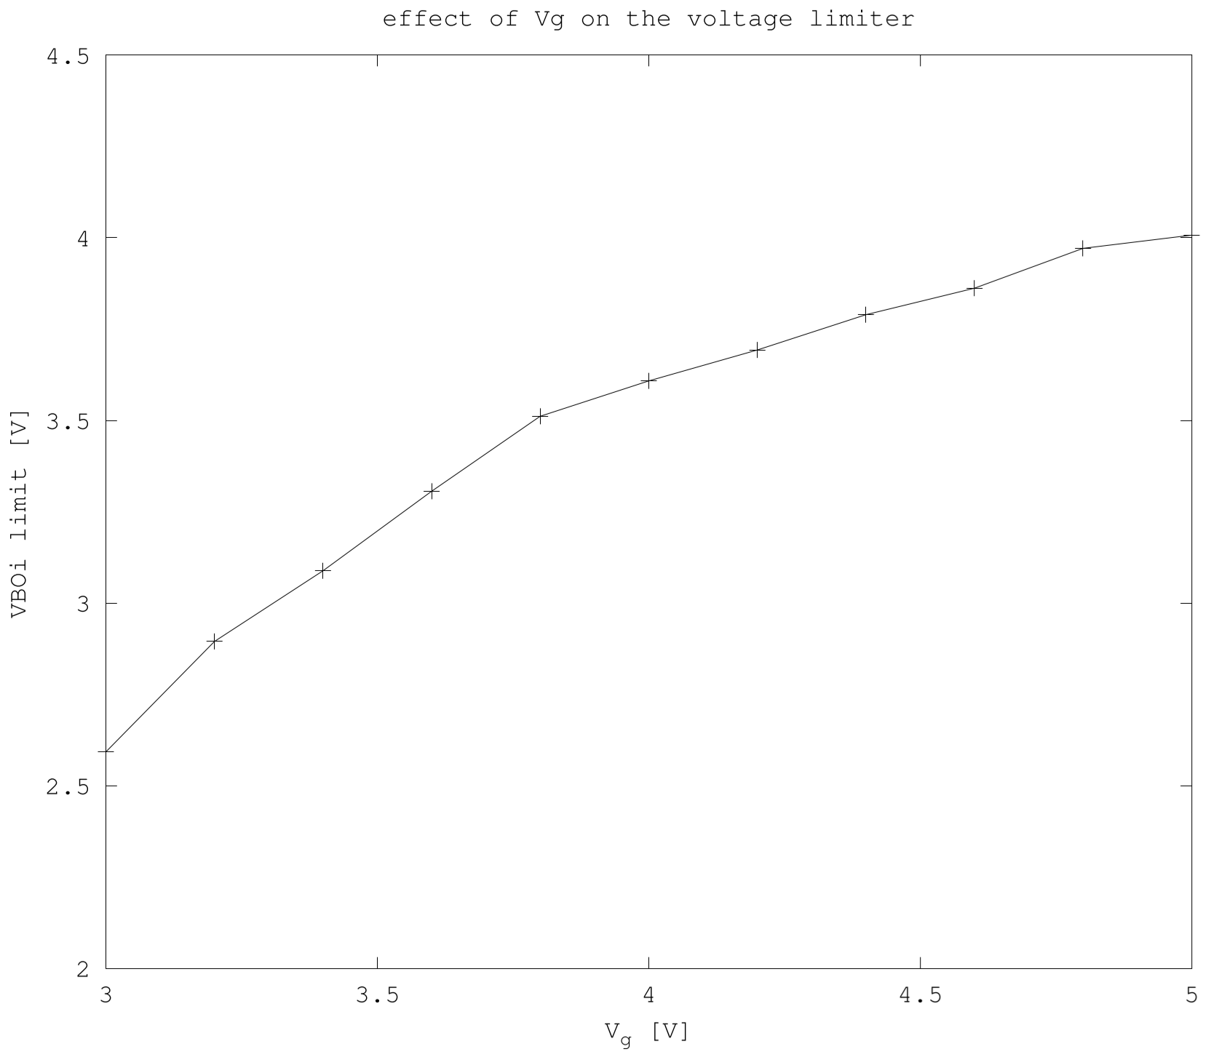
Voltage limiter
Source
follower
vbo
Voltage limiter
Opamp
Source follower
in
out
Integation
capacitance

Slide 30
Methodology and Setup #3
oscilloscope
computer
AFG V_{in}
labVIEW
trigger
USB Cable
bashscript
averaging
octave-cli
sampling
latexmk

Slide 31
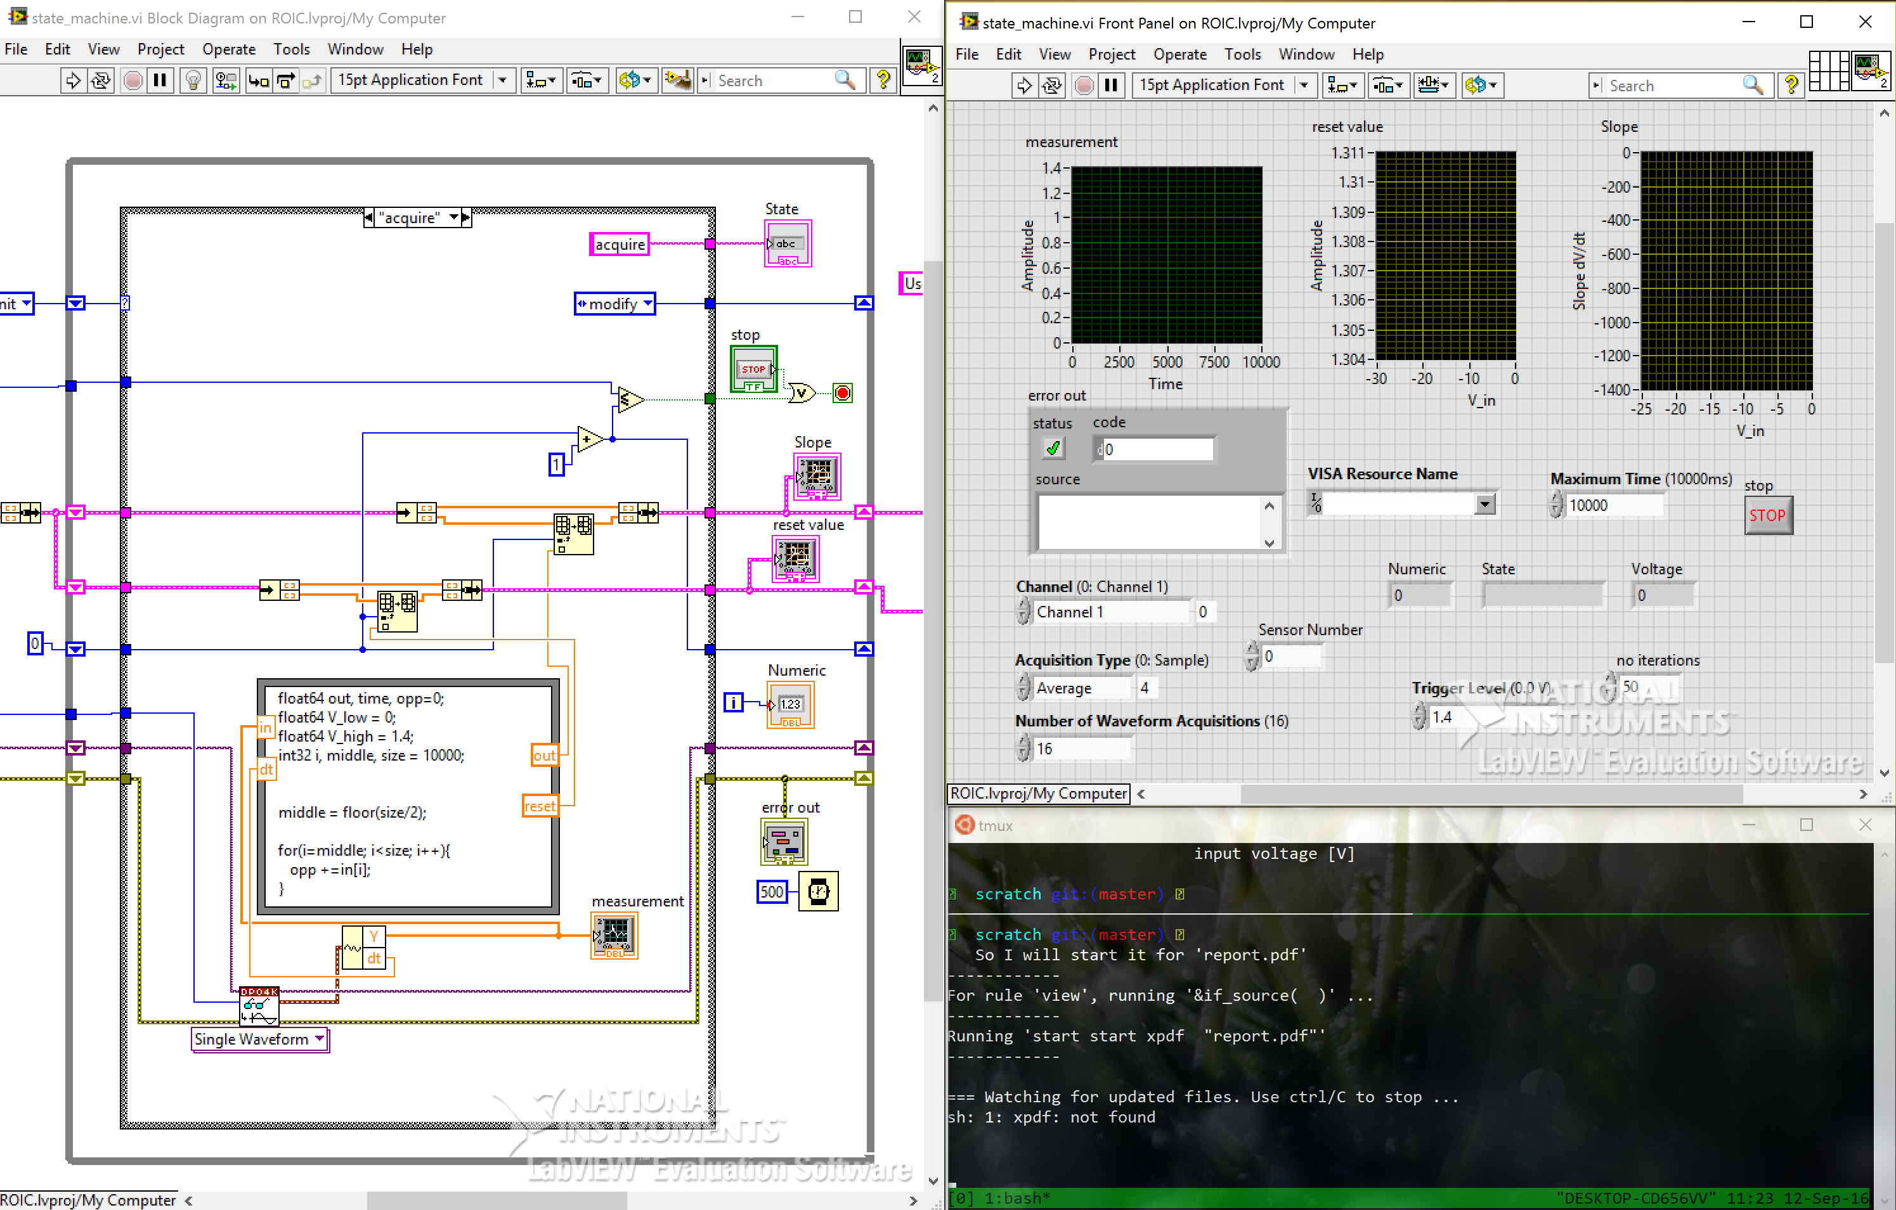
Methodology and Setup #3

Slide 32
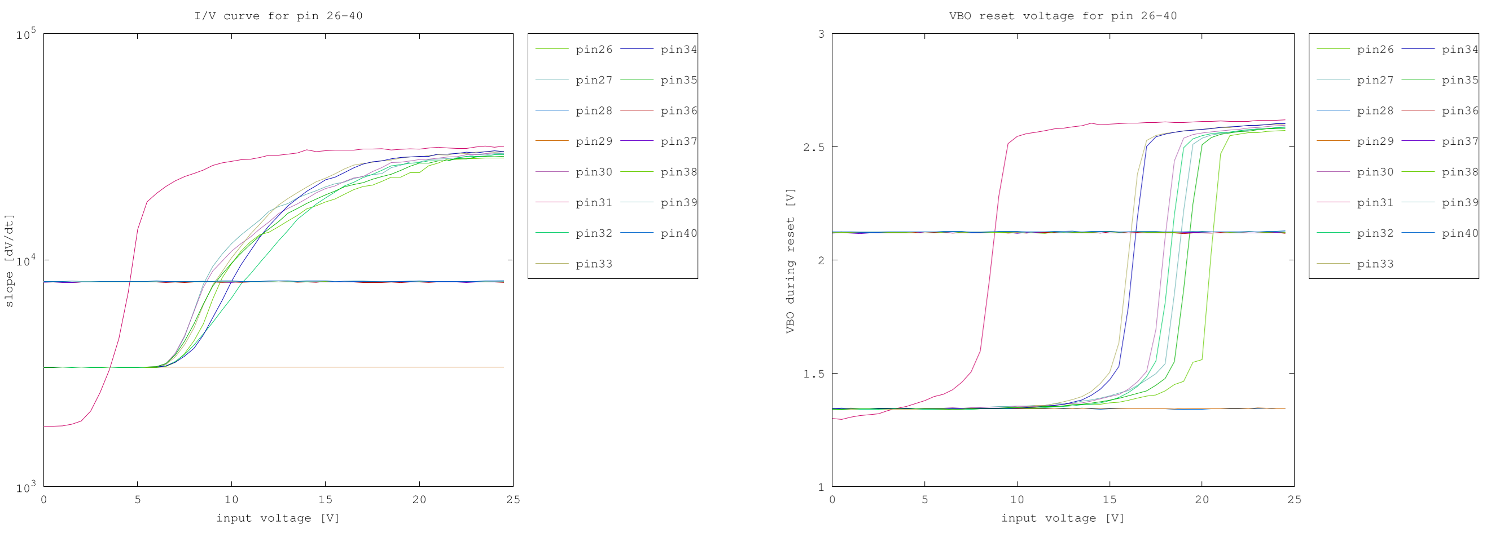
Forward bias

Slide 33
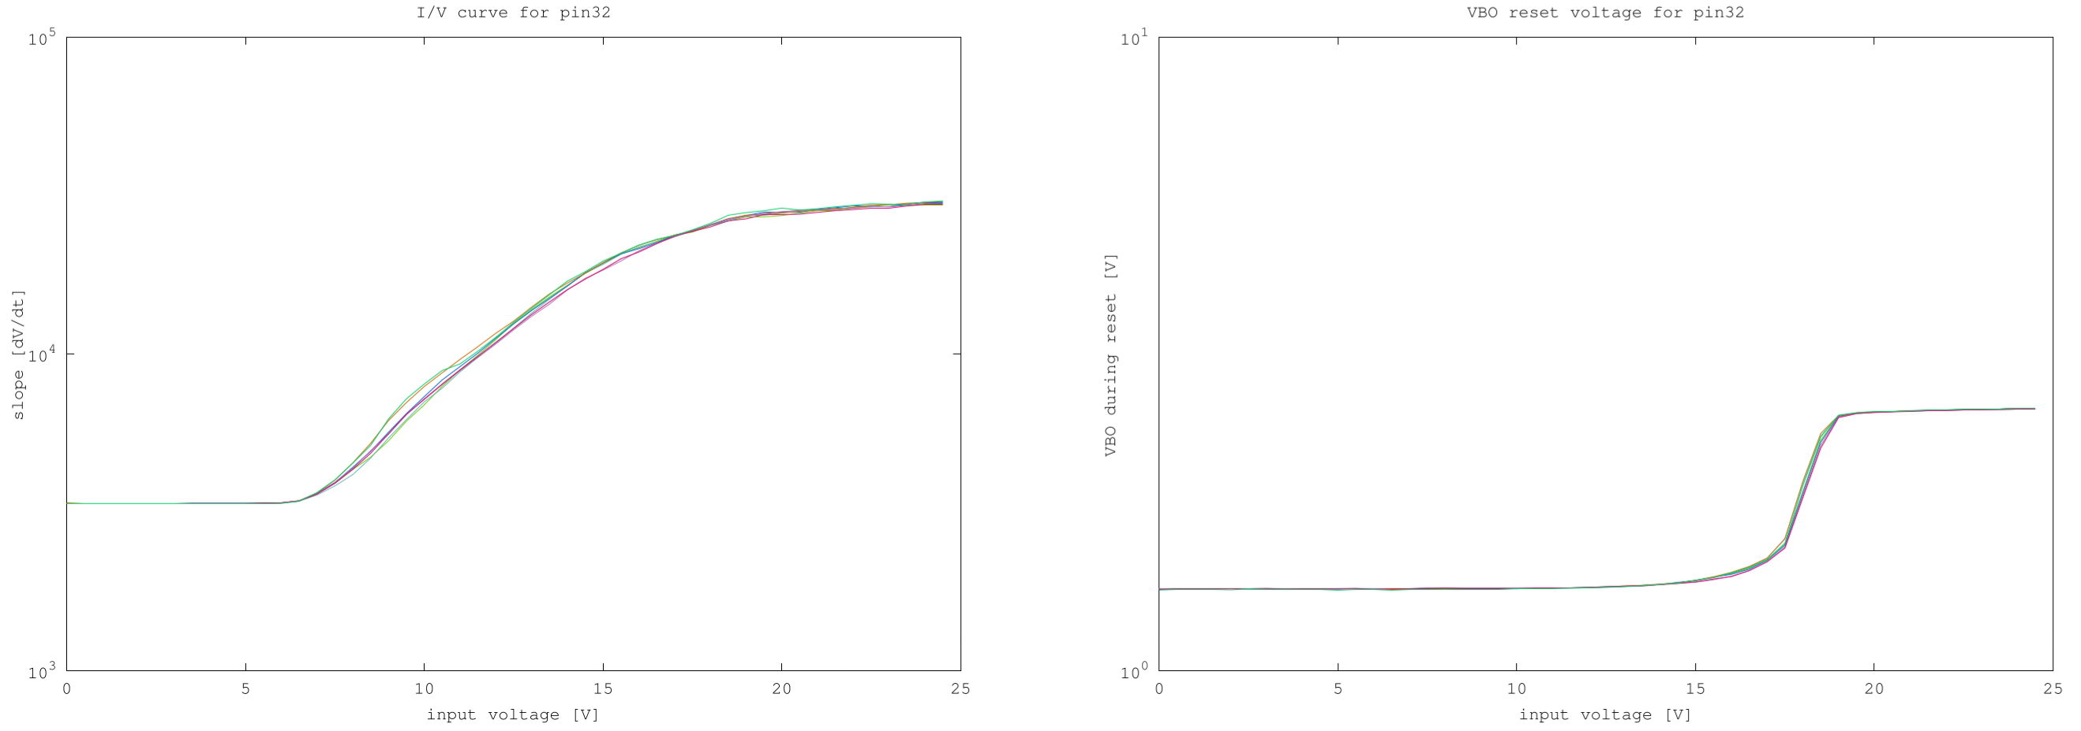
Repeated tests single pin

Slide 34
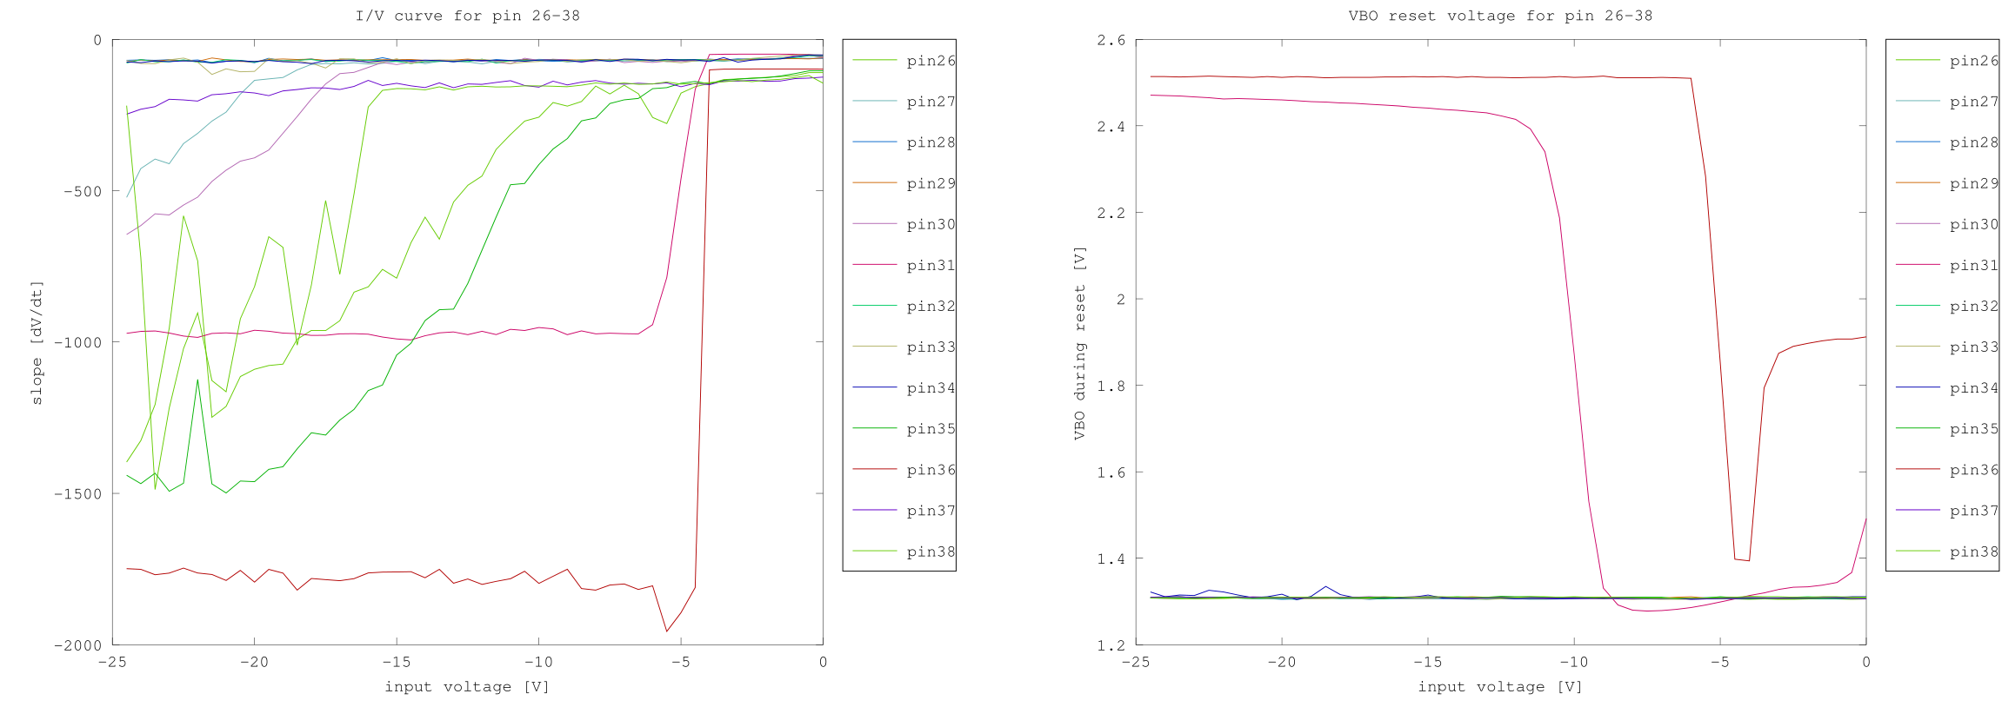
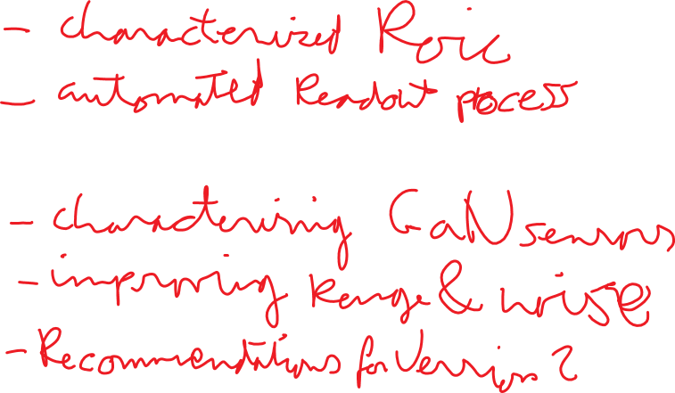
Reverse Bias

Slide 35
Conclusions
Characterized ROIC
Automated GaN characterization process
Continue characterizing GaN sensors
Improve input voltage range
Reduce noise
Recommendations for ROIC 2.0

